Slide 1
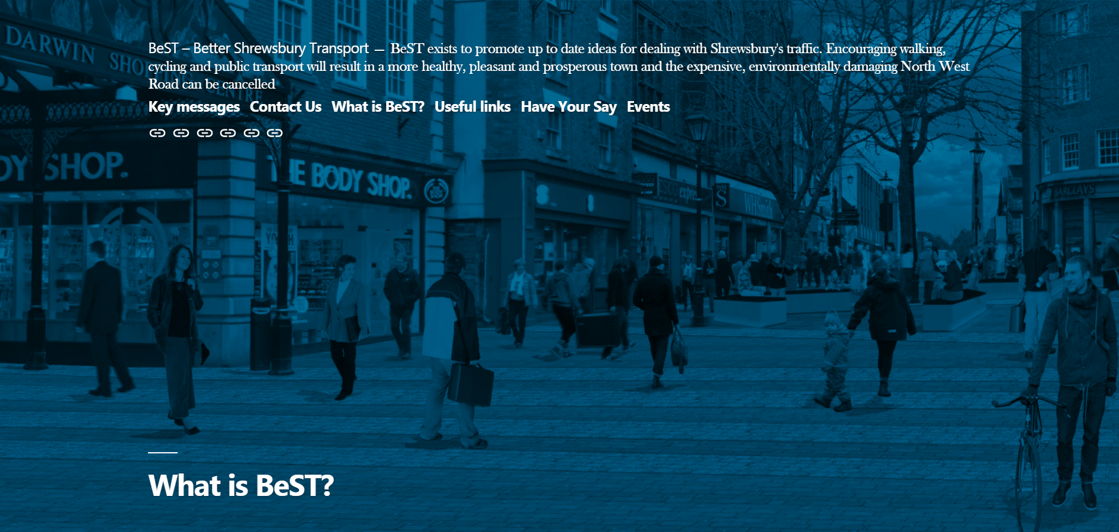
www.bettershrewsburytransport.org

Slide 2
Agenda
Dave Green – Shrewsbury Friends of the Earth
Lynn Sloman - Transport for Quality of life
Robin Mager - Shropshire Wildlife Trust
John Whitelegg - Associate, Centre for Mobility Studies, Kassel, Germany
Q&A

Slide 3
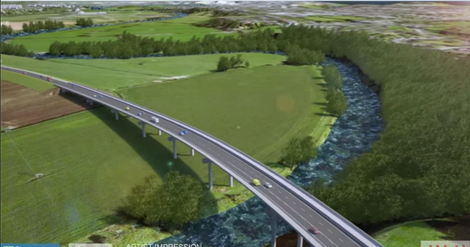
Shrewsbury North West Road, a Critical Appraisal,
Dave Green, Shrewsbury Friends of the Earth,

Slide 4
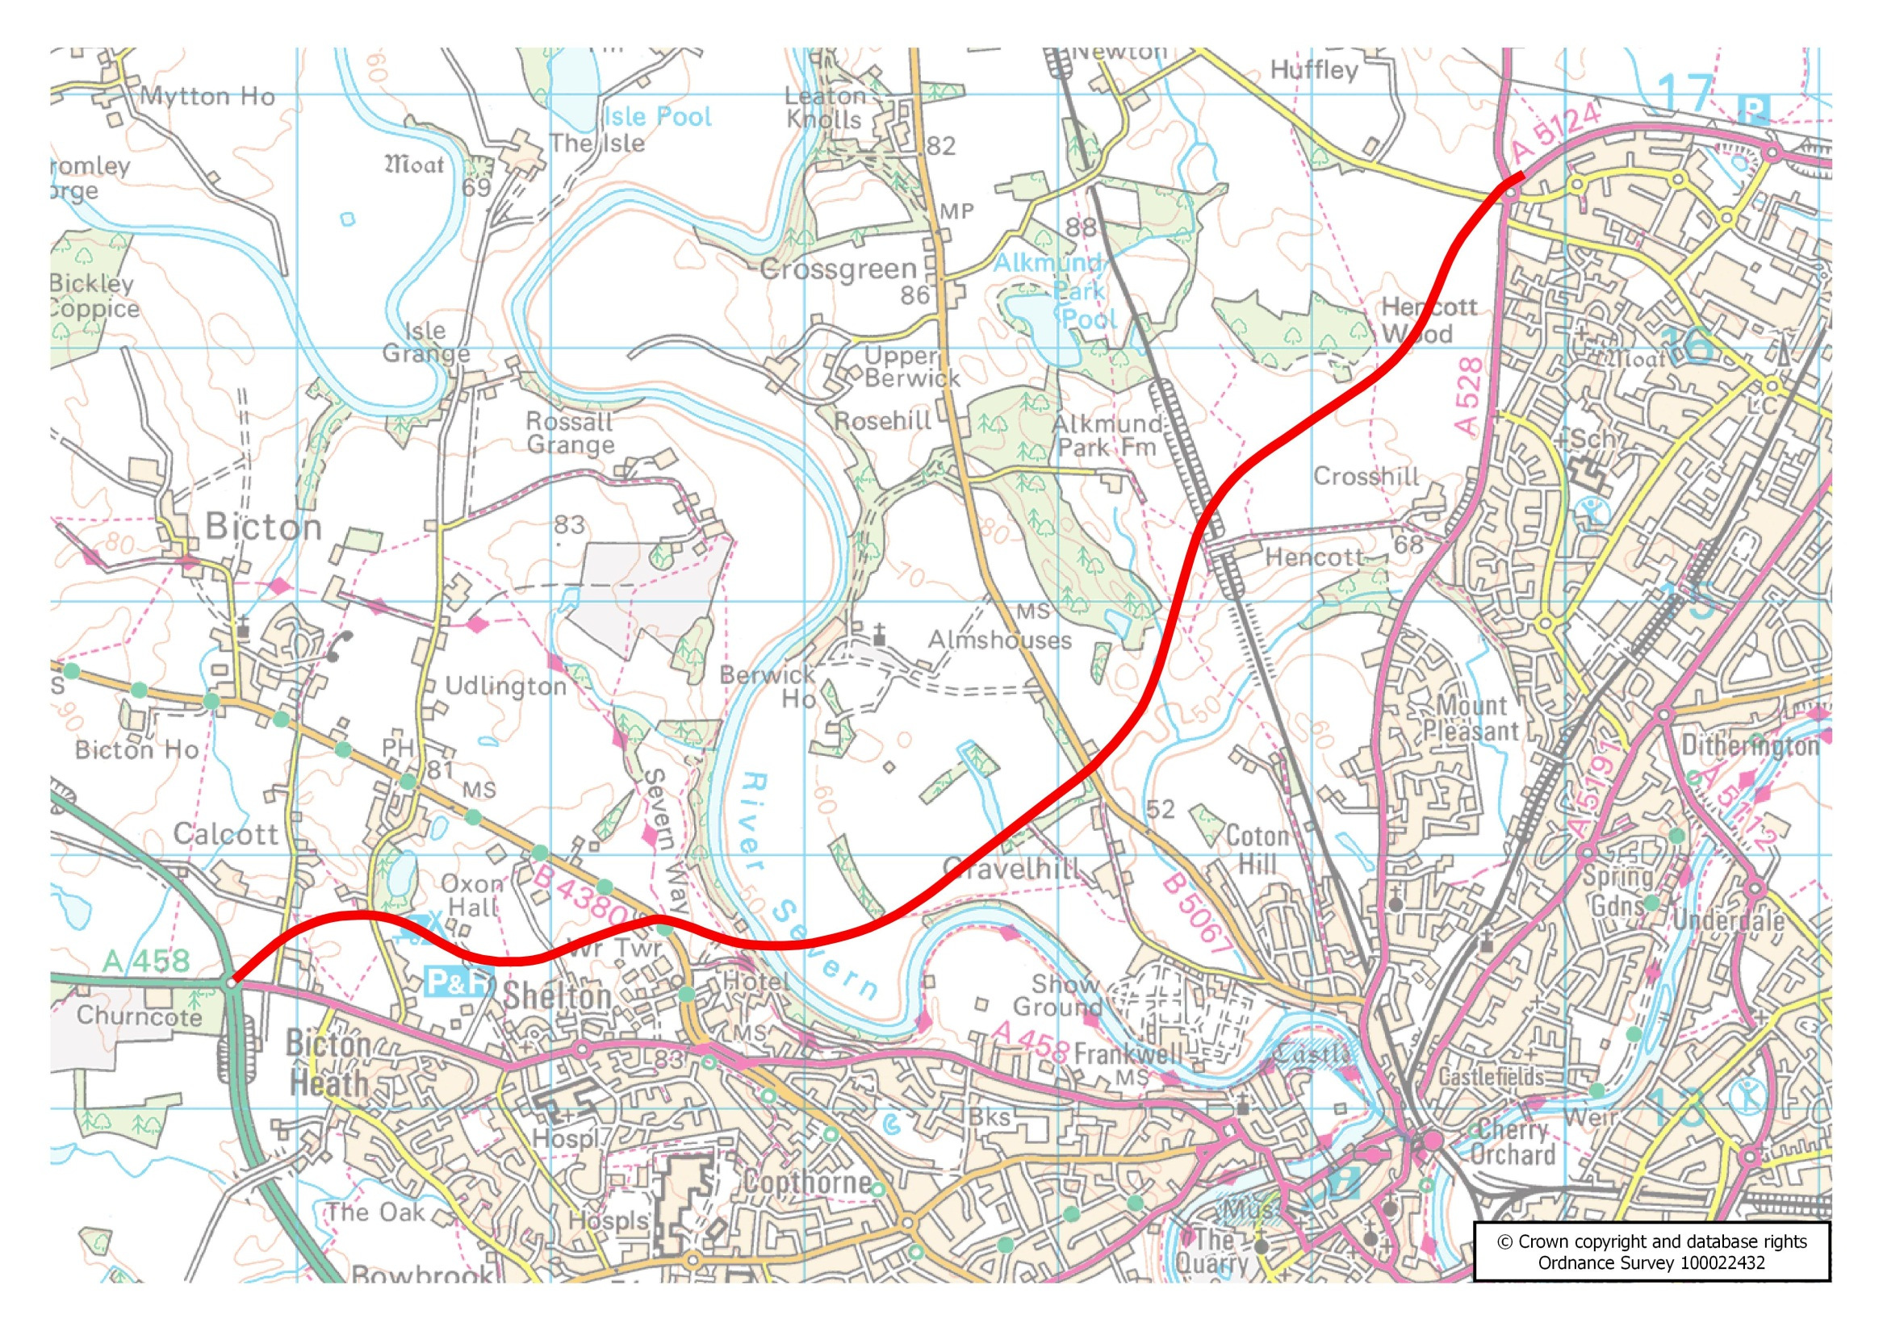

Slide 5
It is clear that
“In almost any vision of a Zero Carbon Britain there must be a shift from the car to more efficient forms of transport”
(Centre for Alternative Technology ZCB 2030 report pg 132).
CAT suggest a reduction in personal car miles of 40%,

Slide 6
It is clear that
“In almost any vision of a Zero Carbon Britain there must be a shift from the car to more efficient forms of transport”
(Centre for Alternative Technology ZCB 2030 report pg 132).
CAT suggest a reduction in personal car miles of 40%,
The House of Commons Select Committee on Transport concurs , stating
“technology alone cannot solve the problem of greenhouse emissions from transport”
(BBC, ‘Ditch cars to meet climate targets say MPs’ 22/8/19),
adding “in the long term widespread personal transport vehicle ownership does not appear to be compatible with significant decarbonisation”.

Slide 7
All Shropshire Council’s figures for traffic in 2037 if the NWR is built relate to a predicted Do Minimum figure for the same year, not back to current traffic levels.
The rise between the current levels and the Do Minimum figure vary from road to road but average around 24%

Slide 8
All Shropshire Council’s figures for traffic in 2037 if the NWR is built relate to a predicted Do Minimum figure for the same year, not back to current traffic levels.

Slide 9
If you compare the NWR figures to 2017 figures the drop is much less.

Slide 10
But for some roads the traffic compared to 2017 goes up not down!

Slide 11
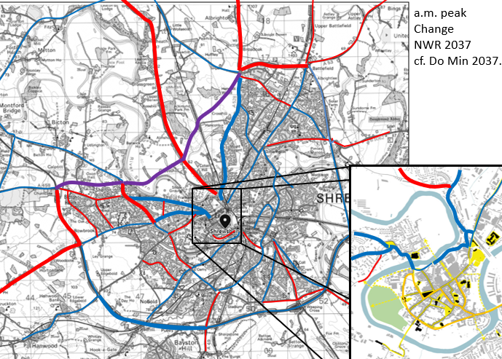
What the NWR would do
Traffic flows in 2037
if NWR is built –
compared to do minimum
am peak
Red is increase,
Blue is decrease
“Traffic will increase on local roads leading to and from the NWR”
From SC’s NWR Outline Business Case Dec 2017

Slide 12
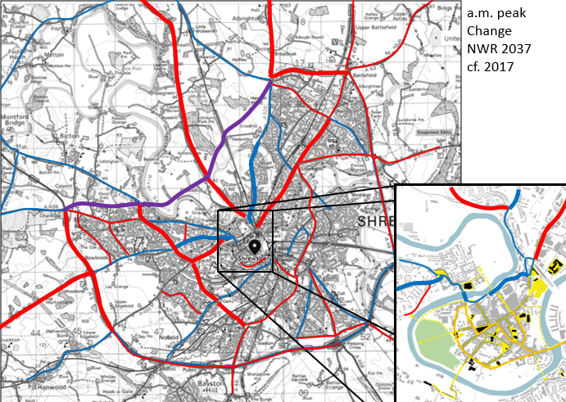
What the NWR would do
Traffic flows in 2037
if NWR is built –
compared to 2017 figures
am peak
Red is increase,
Blue is decrease

Slide 13
What the NWR would do
Increase traffic levels overall,
Increase traffic levels substantially on some existing roads,
According to Shropshire Council’s own Business Case;
Around 50% on current levels on Berwick Rd from Coton Hill out, am peak,
55.4% on Old A5, top of Mount to Mytton Oak Rd, am peak
27.4% on New St, pm peak
41% on A5 between Churncote & Montgomery Rd am peak
11.5% on A49 N of Sundorne Roundabout, am peak.
180% on Berwick Rd S of Leaton am peak
22.5% on St Michael’s St, am peak

Slide 14
What the NWR would do
Increase traffic levels overall,
Increase traffic levels substantially on some existing roads,
According to Shropshire Council’s own Business Case;
Around 50% on current levels on Berwick Rd from Coton Hill out, am peak,
55.4% on Old A5, top of Mount to Mytton Oak Rd, am peak
27.4% on New St, pm peak
41% on A5 between Churncote & Montgomery Rd am peak
11.5% on A49 N of Sundorne Roundabout, am peak.
180% on Berwick Rd S of Leaton am peak
22.5% on St Michael’s St, am peak

Slide 15
What the NWR would do
Plus noise disturbance from the 26 metre bridge & raised section,
Plus divert £25m of local resources from other more worthy schemes, inc wider community facilities, from around the County.
Plus Shropshire Council would be responsible for any overspend!
Plus the cost to the national purse,
Plus the carbon cost of construction..

Slide 16
What the NWR might do
According to SC’s figures traffic on Mardol Quay would reduce
from current levels by 11% am peak
There are slightly greater reductions on Smithfield Rd
- but if the pinchpoint is only 11% down how would that help?
And the model is unlikely to take induced traffic sufficiently into account
20% reductions on Coton Hill are predicted for the am peak
- but this would be the shortest route into the town centre from the ring road?
Larger reductions are predicted for the roads NW of Shrewsbury,
- but there is substantial industrial & housing on this route so this is probably overstated.
Huffley Lane would lose it’s access to the Ellesmere Rd Roundabout
- so even if traffic levels fall delays won’t.

Slide 17
What the NWR would not do
The NWR would not affect most of the town centre, Castle St, Wyle Cop, High St, Town Walls etc
It would not solve air quality problems
It certainly wouldn’t be transformative,
which is the stated aim of the Large Local Majors Fund.

Slide 18
But isn’t the NWR needed for the Growth of Shrewsbury?
There is a lot of development in Shrewsbury at the moment,
- but much of this is catching up on the barren years post 2008,
Going forward there are plans to build 400 dwellings/annum,
- 1% of the current stock,
And not all of these will be occupied by new residents,
And existing household size is still falling
So the growth in population will be much less than 1%/a
It would not take much to counteract a less than 1% growth in population.

Slide 19
So the North West Road would be a road in the wrong direction,
At a time when we need to be concentrating on decarbonising
as fast as possible
& that’s without considering it’s landscape & wildlife affects…...
davidgreen742@btinternet.com
www.shrewsfoe.yolasite.com

Slide 20
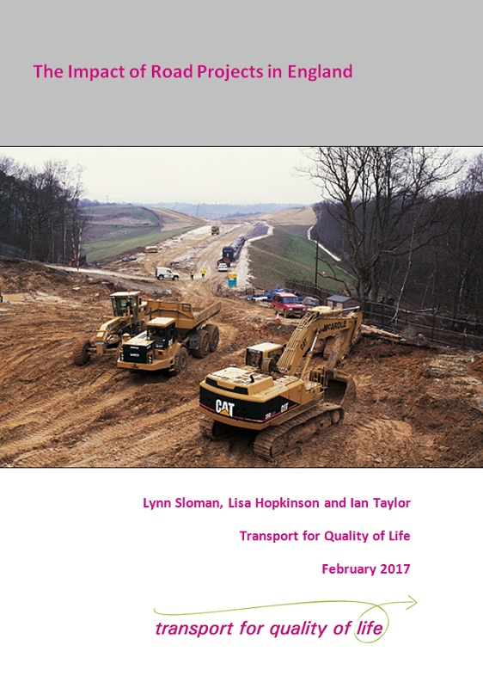
The Impact of Road Projects in England
Do new roads deliver the congestion relief promised?
Do new roads help boost local economies as hoped?
Is the impact on the environment as bad as feared?

Slide 21
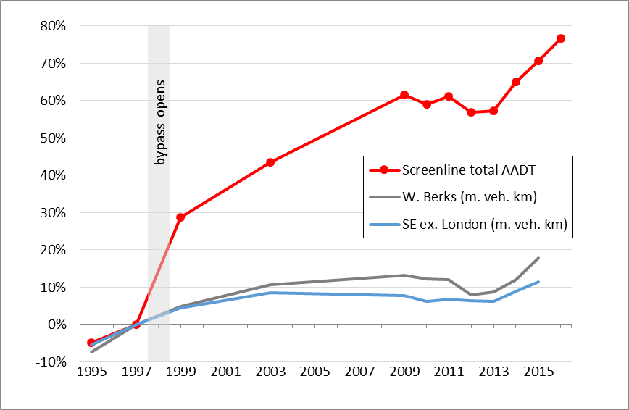
Newbury Bypass: Adding road capacity generates traffic
NEWBURY N-S CORRIDOR

Slide 22
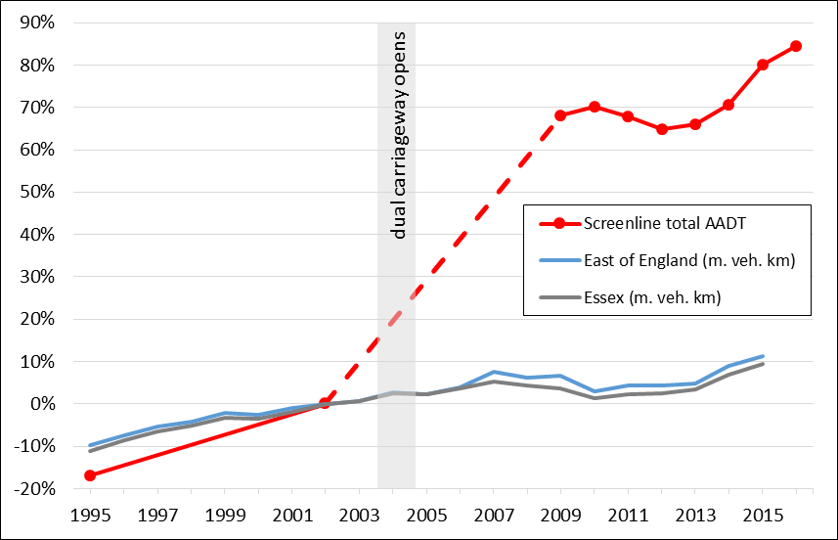
Essex A120: Adding road capacity generates traffic
A120 STANSTED - BRAINTREE

Slide 23
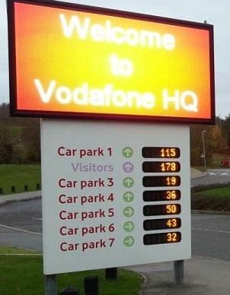
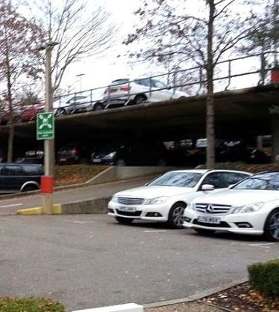
Newbury: businesses move out of town centre

Slide 24
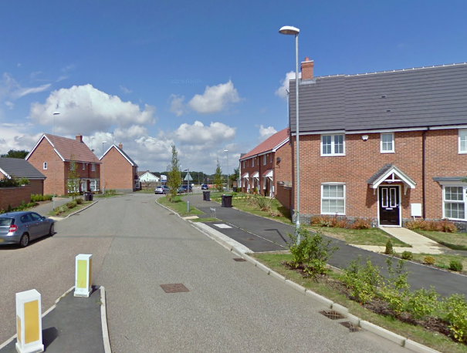
A120 Stansted–Braintree: car-dependent development
Image capture Aug 2010 ©2016 Google

Slide 25
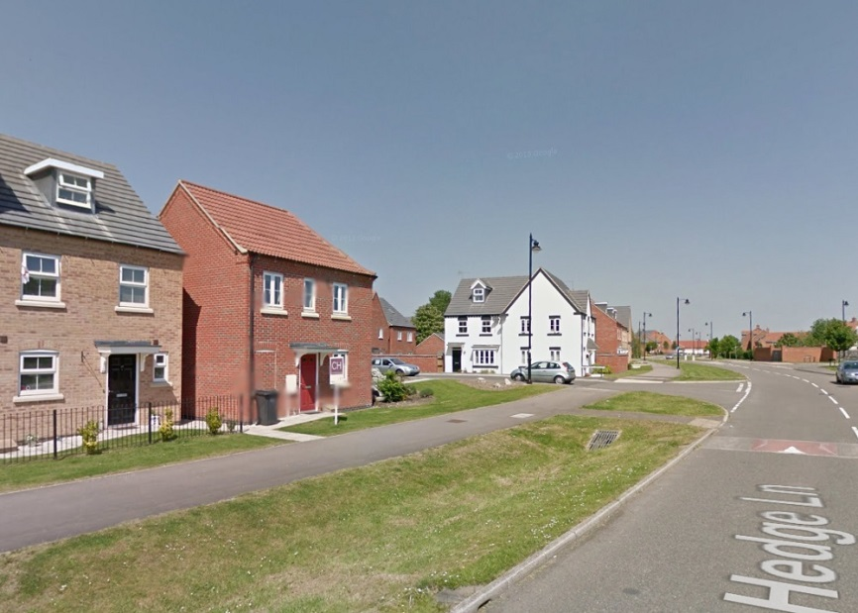
A46 Newark – Lincoln: car dependent development
Witham St Hughs 2500 house development in open countryside
©2017 Google

Slide 26
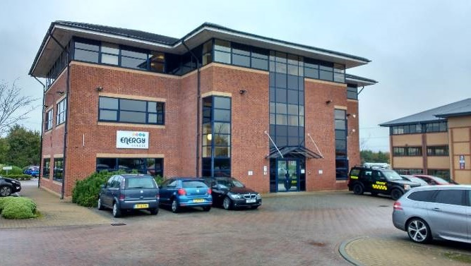
Blackburn Southern Bypass Business parks at M65 junctions undermine town centre
Office units at Junction 4

Slide 27
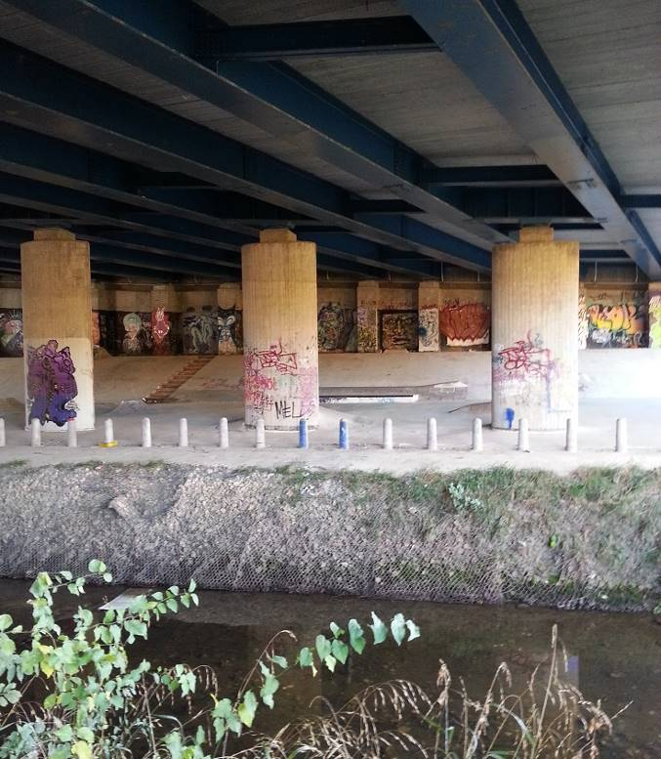
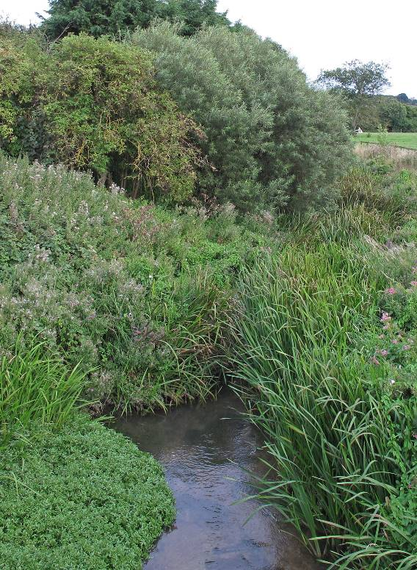
Environmental and visual impact: A120
River Chelmer
A120 crossing R Chelmer

Slide 28
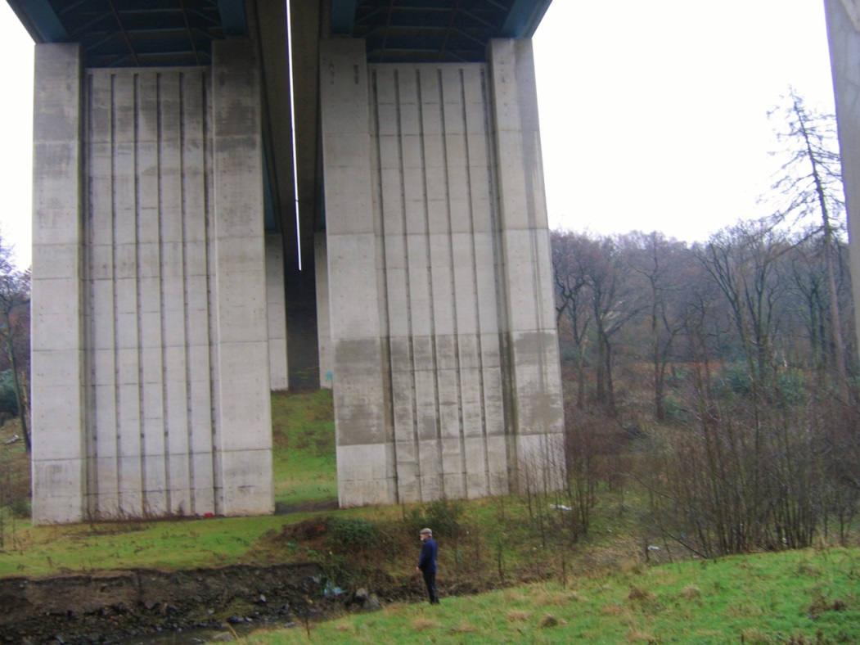
Environmental impact: M65 Blackburn bypass
Ancient woodland
felled for M65 to cross the Stanworth Valley

Slide 29
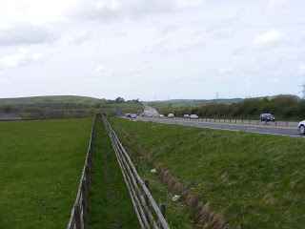
Amenity impact: M65 Blackburn Bypass
Regional walk Witton Weavers Way on lengthy diversion along M65.
A walkers’ guide notes litter strewn from vehicles as ‘plastic bags, fast food containers, a ring-binder file and a pair of trousers’

Slide 30
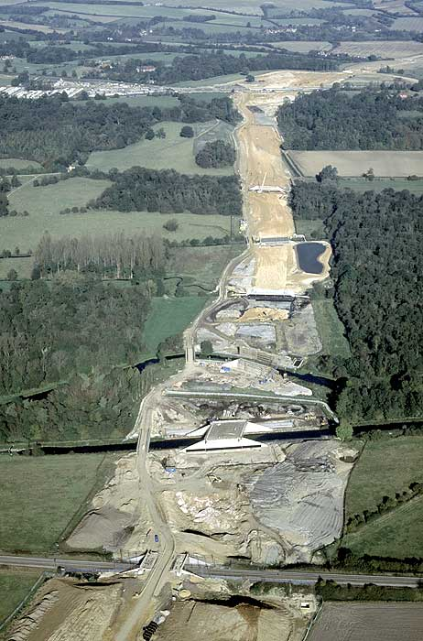
A34 Newbury Bypass
Image: Historic England

Slide 31
New roads = more carbon emissions
Cumulative emissions from 54 road schemes 2002-2010:
8 MtCO₂ (conservative estimate)
Emissions added every single year
1.2 MtCO₂ (conservative estimate)...and rising
= 3% of annual emissions of CO₂ from all motorway and trunk road traffic in England
= an extra 590,000 cars with average mileage and emissions

Slide 32
Next steps
Sun 3 Nov - Walk the route – meet 11:00 Friends' Meeting House on Corporation Lane, Coton Hill
Sat 30 Nov – Shrewsbury Civic Society Open Forum
Shropshire Council consultation – coming soon!
Planning application ‘January 2020’
Planning decision ‘spring 2020’ or Public Inquiry 2021?

