Slide 1
North West Relief Road
Robin Mager
Shropshire Wildlife Trust

Slide 2
“Climate change is probably the greatest long-term threat to biodiversity, and the majority of Britain’s greenhouse gas emissions now come from transport”
(>26%).
The Wildlife Trusts

Slide 3
“The area to the north-west of Shrewsbury, though largely undeveloped, includes a relatively large number of environmental constraints”!
WSP Option Assessment Report

Slide 4
Pros (Maybe?):
Reduced journey time
Reduced congestion
Improved air quality
Reduced carbon emissions
Habitat creation
Restoration of Hencott Pool

Slide 5
Cons (Probably!):
Impacts on species
Impacts on habitats
Impacts on landscape
Impacts on water
Induced demand
Car dependency
More emissions

Slide 6
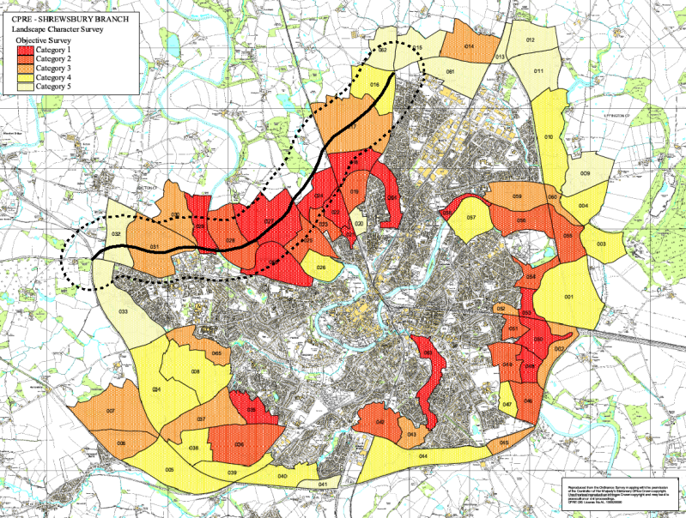
Landscape Character
Notes:
In 2004, CPRE Shropshire, in conjunction with Shropshire Council, carried out an extensive Landscape Character Survey around the then perimeter of the town of Shrewsbury.
This extensive exercise was carried out because, in 1999, the Inspector at the Local Plan Public Inquiry recommended that the policies relating to Areas of Special Landscape Character should be removed from the Local Council’s Proposals Map (the Local Council then was Shrewsbury.& Atcham District Council).
CPRE considered that this left important areas of landscape around the town unprotected, and exposed to development. CPRE Shropshire therefore undertook its own Survey resulting in the map shown here (pdf file).
The completed survey covered 66 separate parcels of land which were subdivided by the quality and character of their landscape.
Only 14 of the 66 land parcels surveyed warranted a Category 1 classification. This was defined as: “Landscape which is outstandingly rich in character. It is generally undeveloped and unaffected by any surrounding development, which, if present, is well screened. In many cases (but not all) these areas are associated with the Severn Valley. Most of these areas include rights of way which are widely used for leisure activities. Development within or adjacent to these areas would be extremely detrimental to the Shropshire landscape as a whole, and to the setting and character of Shrewsbury in particular.”
No less than 8 of the 14 Category 1 areas lie in the northwest sector of the town, which is now under threat from the proposed Shrewsbury North West Relief Road.

Slide 7
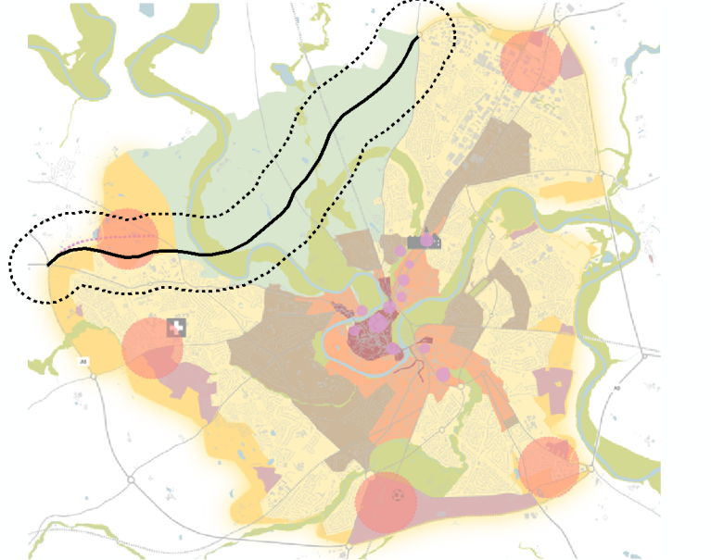
Big Town Plan
Notes:
From the ‘Big Town Plan’ which seeks to “Protect the Green Wedge”.
“The town is blessed with extraordinary greenspaces, courtesy of the River Severn
corridor and a superb landscape setting. However, Shrewsbury does not make the most
of what is has and we want to make greenspace much more accessible for people and to make it richer and more biodiverse. We want people to enjoy better access to the river and other waterside places. We want our Big Green Plan to improve the health and well-being of people in the town, by promoting walking, cycling, greater enjoyment of outdoor space and greater access to the countryside.
Our aims are:
To connect up the wider greenspace network across the town, making new green links where possible and improving existing links and green corridors;
To make much more of the River Severn corridor and its tributary valleys and brooks that form key green spaces within the heart of the urban area ;
To ensure that new development, wherever it is planned, delivers better quality and strategic greenspace that connects to our existing green spaces and proposed new corridors.

Slide 8
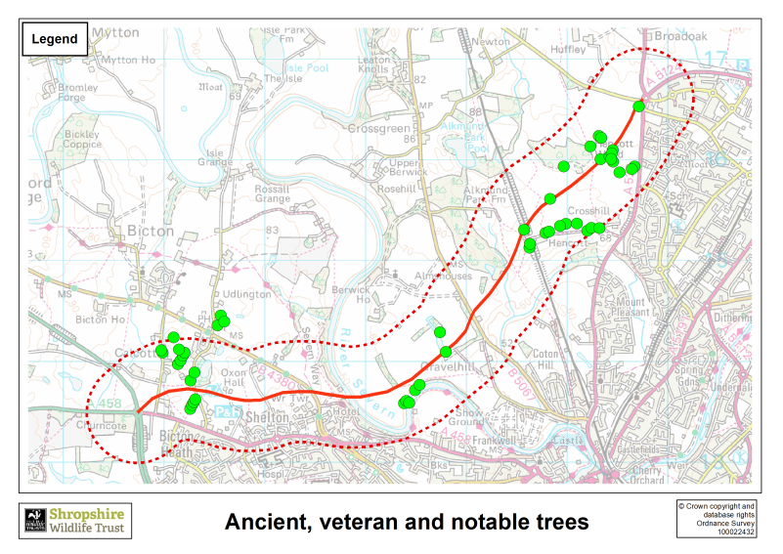
Rob McBride, known as the Tree hunter, is a director of Treespect CIC, a Shropshire based, not for proft, community interest company and official Ambassador for #TreesInNeed across Europe.
Notes:
Ancient, veteran and notable trees along the route.
Dotted line shows a 500m buffer.

Slide 9
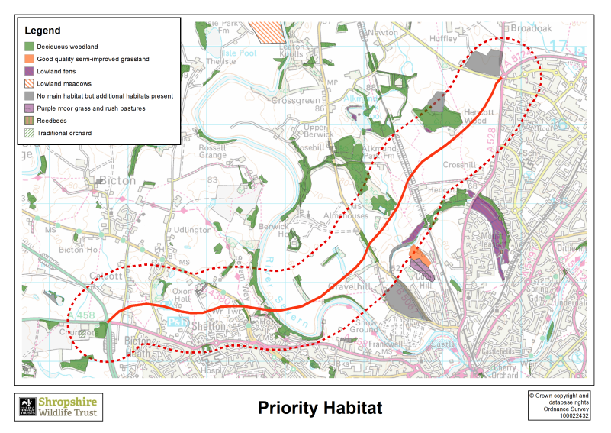
Notes:
Priority Habitat along the route.
Dotted line shows a 500m buffer.

Slide 10
Within 500m of the proposed route:
over 860 animal species have been recorded including:
12 nationally scarce species of invertebrates
3 species of bat
7 species of national importance including:
  Toad
  Great Crested Newt
  Water Vole
  Hedgehog
  Brown Hare
  Otter
  Badger
  Polecat

Slide 11
Within 500m of the proposed route:
over 100 bird species have been recorded including:
19 on the red list
34 on the amber list
Barn Owl
Cuckoo
Curlew
Hen Harrier
Kingfisher
Lapwing
Lesser Spotted Woodpecker
Skylark

Slide 12
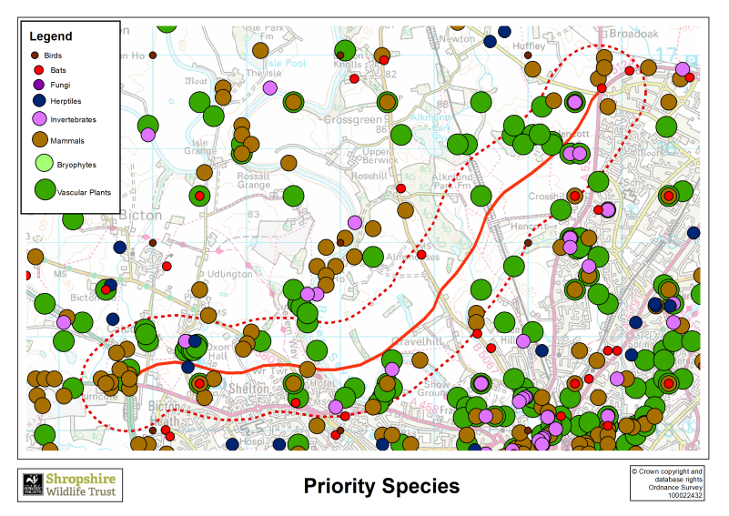
Notes:
Protected and Priority species along the route.
Dotted line shows a 500m buffer.

Slide 13
Within 500m of the proposed route are:
4 Local Wildlife Sites
  Oxon Pool
  Shelton Rough
  River Severn (Montford - Shrewsbury)
  Old River Bed S'bury (Non SSSI - Hencott Section)
Alkmond Park Coppice (Ancient Woodland)
Hencott Pool (SSSI and RAMSAR)

Slide 14
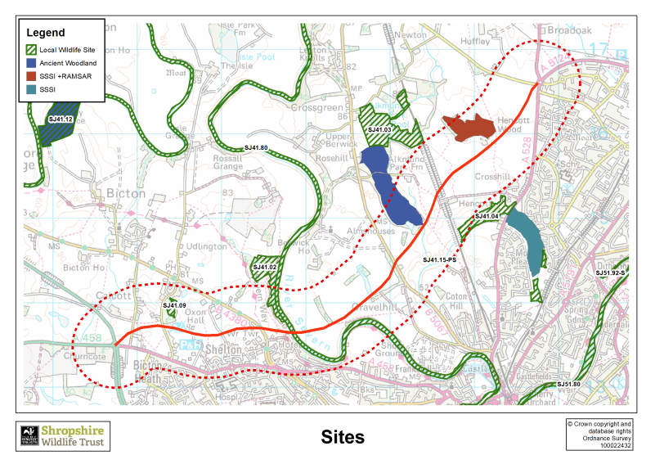
Notes:
Designated ecological sites along the route.
Dotted line shows a 500m buffer.

Slide 15
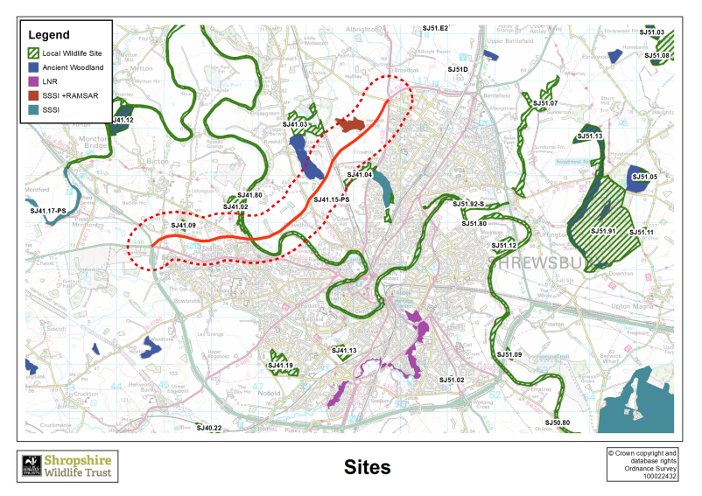

Slide 16
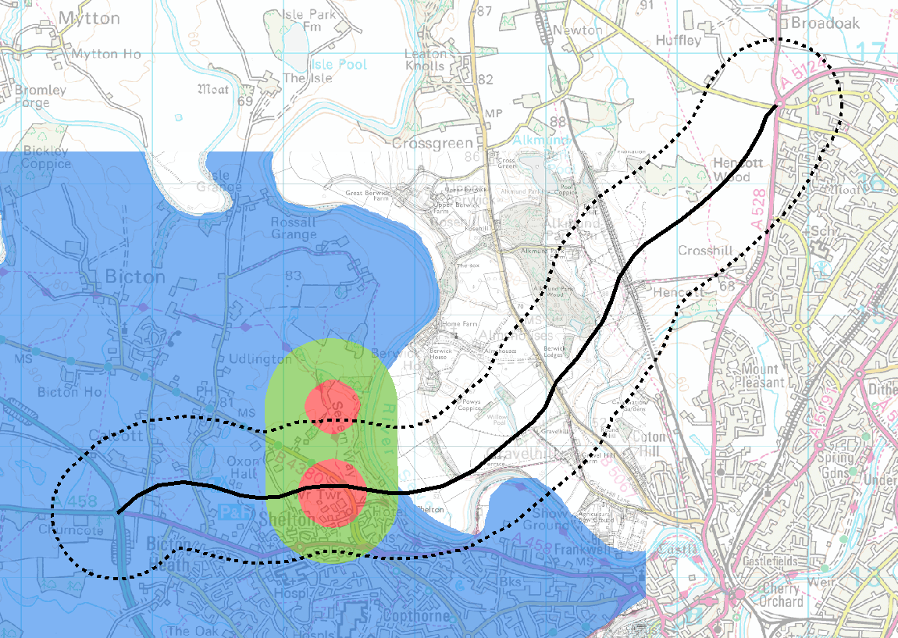
Water Supply
Notes:
Threats to water supply.
Red = areas that require greatest protection
Contamination would threaten the water supply for Shrewsbury hence concerns/opposition from the Environment Agency and Severn Trent Water.

Slide 17
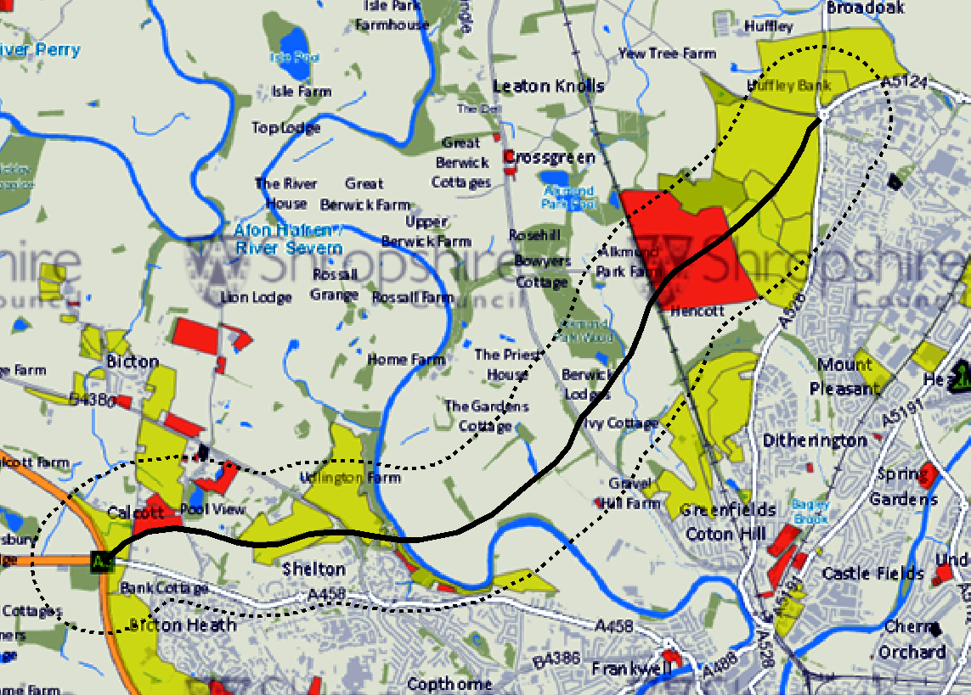
Development
Notes:
Housing allocations.
The road is opening up new areas for development and further areas are planned. These are not necessarily the most appropriate areas for new houses.
New developments are likely to be car dependant and so add to the traffic problems.

Slide 18
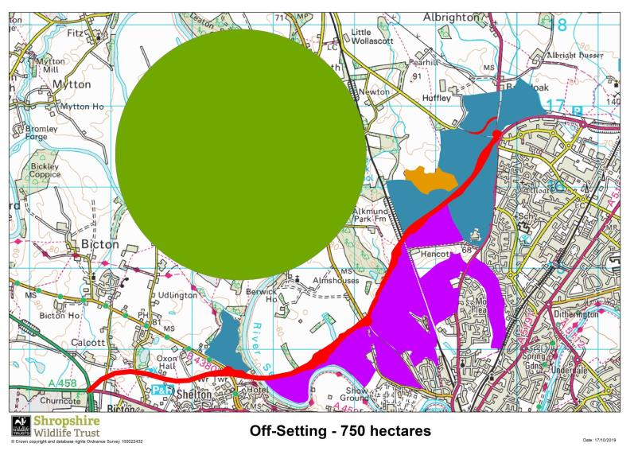
Off-setting
Notes:
Areas impacted by the scheme:
Red – the route itself.
Purple – land isolated from the sider environment.
Blue – land lost to associated development.
Using Defra’s biodiversity offsetting metric it would need something approximately the size of the green area to provide adequate offsetting for the overall impacts – it’s ≈ 750 hectares.
It may not all fall within the programme for the road but it should be included and accommodated within the Local Plan, which is currently under review.

Slide 19
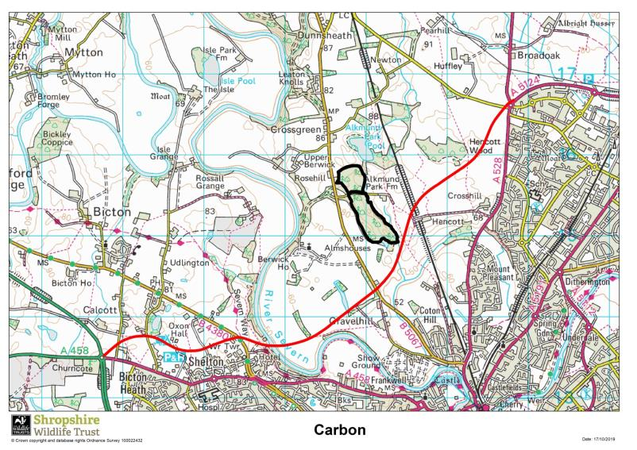
Carbon
Notes:
In addition to biodiversity offsetting which just looks at habitats there will be an impact from the additional traffic. When they talk about “relief” this is just specific roads within the town not overall number of vehicles which will increase considerably.
I cannot find any figure in the business case so using standard figures for emissions per km, the length of the road, the predicted traffic volume figures and figures from the carbon offsetting industry it would appear that at least an area the size of Alkmund Park Wood would need to be planted every year to capture the carbon generated!

